Slide 1
Economic Crisis and Resilience in Central and Eastern Europe
Anita Pelle, associate professor, Jean Monnet Chair
University of Szeged (Hungary)

Slide 2
The EU post-crisis
Growth returned in the EU and the Eurozone in 2013
however, countries have followed different paths
Employment has been growing again as well since 2014
national varieties
Public finance situation is not favourable overall
debt stuck at high levels in some countries

Slide 3
GDP (at market prices, %, 2010=100)
Baltics:
more or less a single track
high improvement pre-crisis
large fall-back due to crisis
back on long-term path
CEE:
hit by crisis, back to growth path
Slovenia had its own crisis
Hungary: almost a decade lost

Slide 4
Employment (in 1,000 persons, 1999Q1-2019Q1)
CEE:
each country going its own way
Baltics:
jobless growth (both before and since crisis)

Slide 5
The competitive advantage of the CEECs
Until the crisis, the nature of CEECs’ competitive advantage lied mainly in the combination of:
EU membership
favourable geographical location (proximity to headquarters as well as markets)
low wage for relatively high-skilled employees
growth potential (sectoral, productivity, and national economic) with a developing business environment
During the crisis:
earlier convergence process stopped (Pelle et al. 2019)
within-EU structural polarisation (Kapeller et al. 2019), CEECs’ semi-peripheral status consolidated (Farkas 2017)

Slide 6
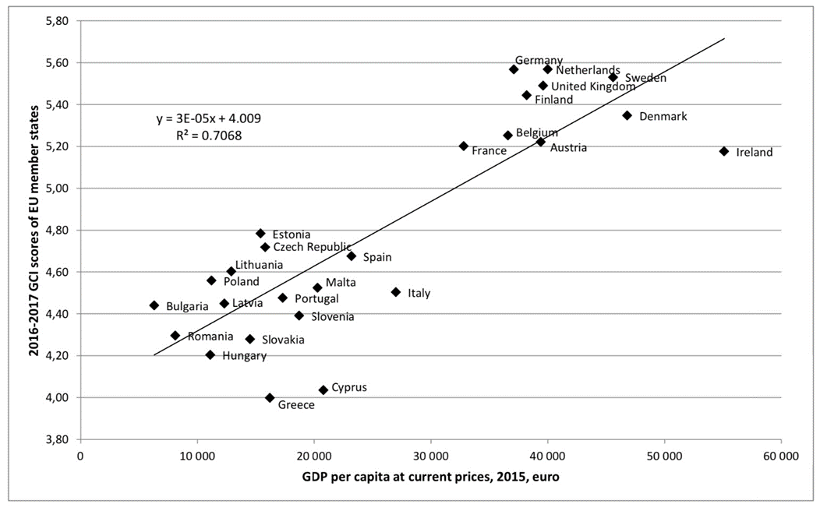
The Intra-EU Post-Crisis Divide
Post-crisis EU is divided into a core and a periphery
Core:
was highly resilient to the effects of the crisis
advanced economies
high value-added
Periphery:
Southern Eurozone and post-socialist new member states (NMS)
countries hit hard by the crisis
constrained into (Eurozone periphery) or opting for (NMS) cost competitveness
Pelle, Anita (2017): The intra-EU migration challenge in the light of Kaldor’s legacy. Acta Oeconomica, 67 (s1): 175-196.

Slide 7
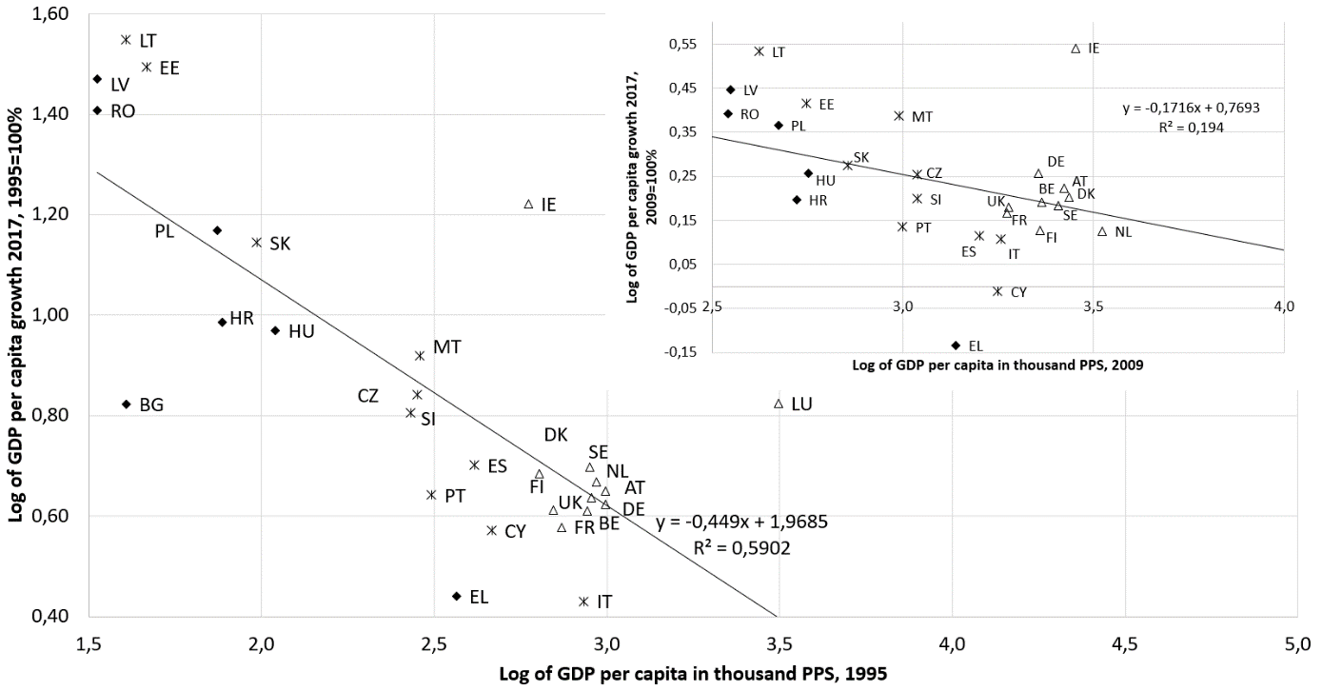
Relative positions of EU member states post-crisis
β-convergence in the EU, 1995-2017 (large figure), 2009-2017 (figure in figure)
β-convergence implies that countries initially less developed exhibit higher growth rates and thus there is upward convergence
Regarding the full period (1995-2017) there is β-convergence in the EU, but post-crisis (2009-2017), there isn’t
Kuruczleki, Éva – London, András – Pelle, Anita – Végh, Marcell Z. (2019): Testing various European capitalism models: The case for growth, convergence, and responses to the crisis. WINIR Symposium Global Capitalism and Its National Varieties in an Era of Crisis, London, 16-18 Dec

Slide 8
The CEE region has recovered from the (previous) crisis
GDP per capita in PPS (EU28=100)
Czechia is currently at ca 90% of EU average
Slovenia is back on track but earlier level of convergence not yet achieved
HU, PL, SK: return to convergence after many years of stagnation due to crisis
Romania surpassing Croatia
Bulgaria: slow but steady convergence farthest from EU average
BUT: CEECs "moving into the slow lane" (Astrov et al. 2019) from 2020 onwards
Source: Eurostat [tec00114]

Slide 9
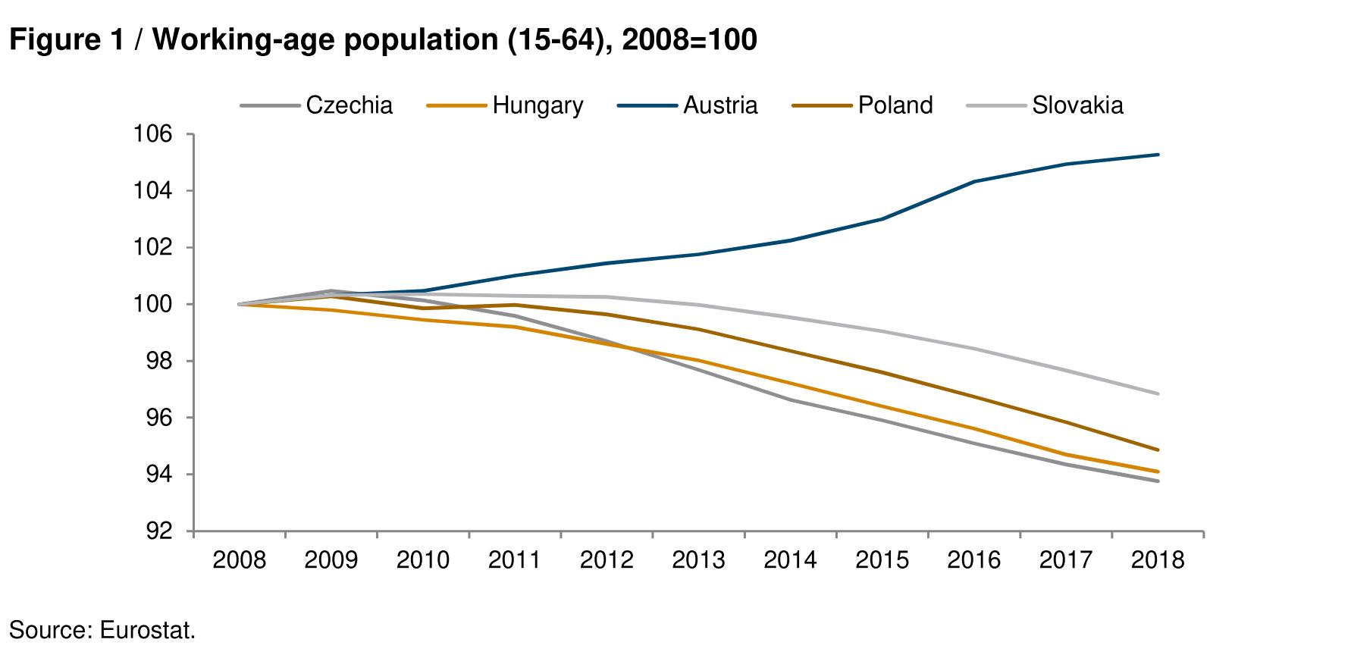
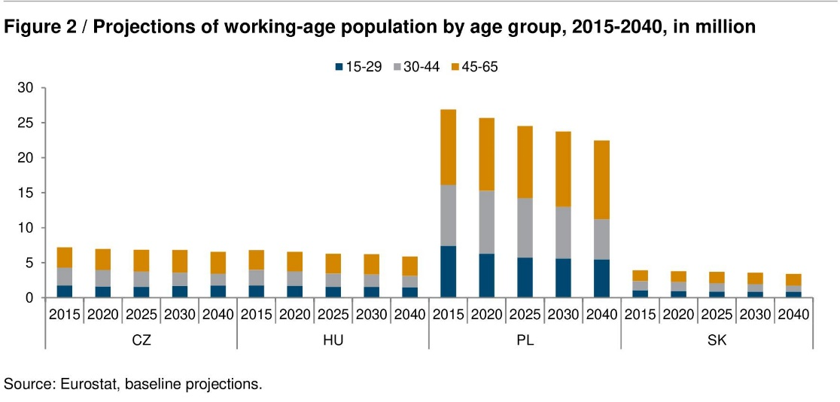
long-term Labour market trends in CEE
Shrinking working-age populations everywhere in the region
largest rate of decline: Poland
tipping points in the early or mid-2020s
To be only partly offset by positive net migration even in the most optimistic scenarios
(Astrov 2019)

Slide 10
Current state of European economic integration
The financial and economic crisis was a ‘game changer’ for the EU
…and now COVID-19 is likely to be the next one…
Internal structure of the EU has changed considerably
core-periphery divide persistent though
core countries: enduring steady performance, coped well with the crisis
Eurozone periphery: deteriorating performance, long-lasting negative effects of crisis
Eastern new member states: crisis put a halt to earlier impressive convergence; diverse paths since then

Slide 11
Thank you for your kind attention
pelle@eco.u-szeged.hu

