Slide 1
Dancing with uncertainty Gertrud Kendernay-Nagyidai, iASK SUMMER UNIVERsity, 2020
How the European Parliament establishes its workings during COVID-19

Slide 2
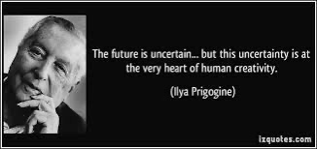

Slide 3
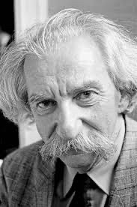
Unpredictability
“The fact that possibilities are inexhaustible at the moment of an explosion imparts limitless informativity to the process – it cannot be predicted. At the same time, the explosion carries the process over into another normative system so that any turning back in the opposite direction is also impossible…. The unpredictable element becomes an act, in unavoidably subjected to interpretation, and is attributed with additional motivation after the fact.” (Lotman pp 67)

Slide 4
“Virus cannot defeat democracy. Democracy cannot be suspended in face of COVID-19”.
President Sassoli twitter

Slide 5
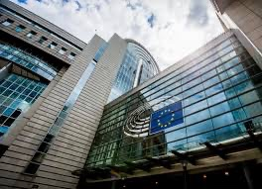
The European Parliament

Slide 6
How Institutions Think?
Institutions create shadow places in which nothing can be seen and no question asked. They make other areas show finely discriminated detail, which is closely scrutinised and ordered. (Mary Douglas).

Slide 7
Institutions do not think rather they constrain and mould human cognition.
The Denkkollektiv or the thought collective or thought world is the social system, in our case the governing bodies, the committees – both the administrative and the political side, the MEPs themselves – in its turn the communication of thoughts necessary for the political administrative, institutional message that reinforce the Denkkollektiv.

Slide 8
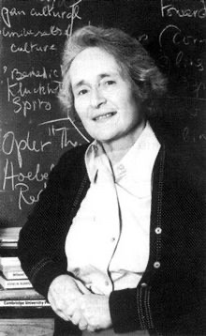
Institutions perform the same task as theory. They also confer sameness. (Douglas)

Slide 9
The enemy of pluralism is monism -- the ancient belief that there is a single harmony of truths into which everything, if it is genuine, in the end must fit. (ISAIah Berlin, 1998)

Slide 10
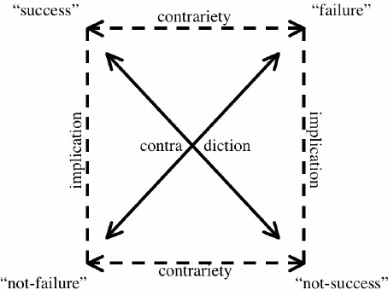
Greimas’ Semiotic Square

Slide 11
Thank you for your attention!

